Slide 1

Submitted By: Himani
ENTERTAINER DATA ANALYSIS

Slide 2

Contents
➤Introduction
➤Given Tasks
➤Data Preparation and Description
➤Visuals
➤About Tools and Theme
➤Analysis

Slide 3
Introduction
□➤ Normal life can be stressful, and people need to relax. Being entertained by others is a wonderful way to take some time out of life. It can reduce stress and make life's issues easier to face. The media and entertainment industry consists of film, television, radio and print. These segments include movies, TV shows, radio shows, news, music, newspapers, magazines, and books. Entertainment industry is a group of sub-industries devoted to entertainment. Entertainment industry is used to describe the mass media companies that control the distribution and manufacture of mass media entertainment.
□
□ ➤ Advantage : Analyst can easily show about the Famous Entertainer through the Dashboard in terms of how many awards He/She won.

Slide 4

Write the process the data added to the current dataset. In addition,mention the theme on which you will be creating the
02 Dashboard.
01
You can add your data as per your Convenience.
Given Tasks
Do the Data Preparation part.
03
Build the Dashboard.
04
05
Build a Storyline

Slide 5
➤Data was given into three parts : (1)Entertainer – Basic Info
Data Preparation & Description
(2) Entertainer –Breakthrough Info (3)Entertainer – Last work Info.
➤I Combined them into a simple file named “Entertainer_final_data “.
➤GIven data is not that much sufficient for analysis part , so additional information is required to add.
➤I Added number of awards and nominees won by them, awards from breakthrough etc.
➤Data is in form of numeric and alphabets
➤Additional data is added from IMDB’s official website.
➤Source: IMDB.

Slide 6
Column Name
Description
Entertainer
Gender (traditional) Birth Year
Year of Breakthrough/#1 hit/Award Nomination
Breakthrough Name
Year of first Oscar/Grammy/Emmy Year of Last Major Work (arguable) Year of Death
Award won from Breakthrough
Total Awards Won Total Nominees Profession\
Oscar won Grammy won Emmy won Other Award
Name of the entertainer. Gender of that entertainer. Birth year of that entertainer.
Here, breakthrough means super hit or career changing performance. Column shows year of breakthrough.
Name of breakthrough. It can be either a musical album or TV show or movie.
Year of first mega award they won.
Last major show or movie or album. You can also say last appearance. Entertainer’s year of death, if they die.
Any award/s from breakthrough. I only wrote about the mega awards
they won in this column. If they had other awards for breakthroughs, I wrote “other”, if they didn't, I wrote “No Award”. If they have a mega award, I wrote that award name.
Total awards that entertainer won throughout.
Total nominees for which they have chosen for award.
Category of entertainer either singer or actor. Pop stars and dancers are included in singers and TV hosts and TV actors are included in actors.
Number of total Oscar awards they won. Number of total Grammy awards they won. Number of total Emmy awards they won.
Number of other awards they won apart from Oscar, Grammy and Emmy.

Slide 7




TOOLS USED

Slide 8

Theme
Decide top Entertainer Based on awards they Won Analyse them

Slide 9
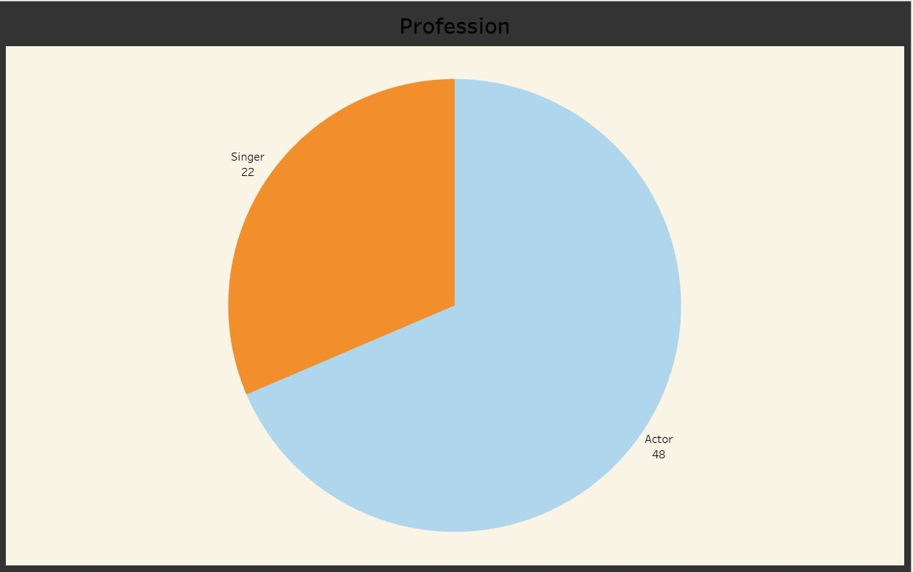
Visuals
□➤Distribution of
Entertainers into
their respective Categories.
□
➤Pop Stars , Dancers , Rock Stars are added into Singers.
□
➤Hosts and tv Actors are divided into Actors.
□
their main passion.
□ ➤Some | allrounders | (Actors | +
Singers) | are added | according | to

Slide 10
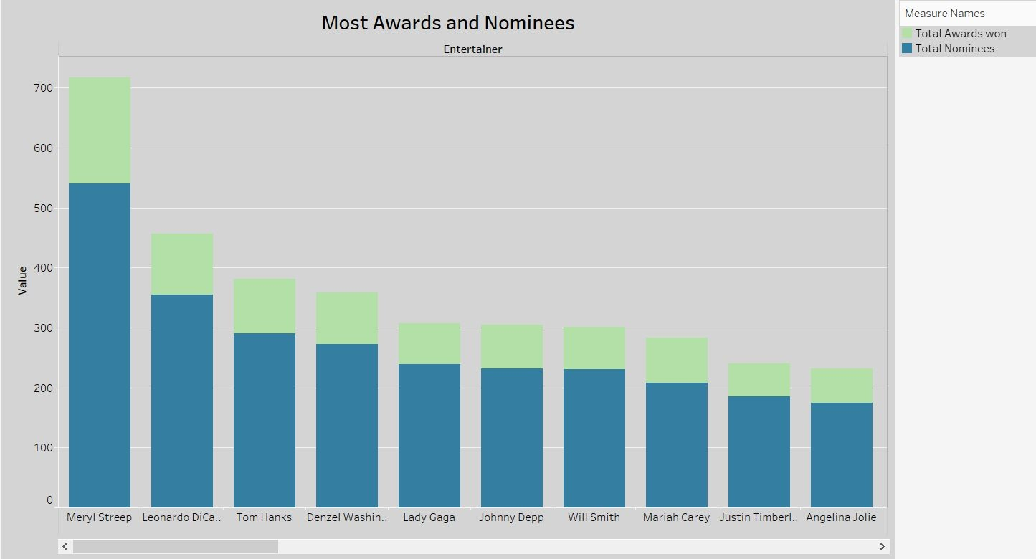
Most Awards and
Nominees
□➤Most number of Awards with Most Nominees
□➤The Green bar shows the total Awards Won and Blue bar shows the total Nominees

Slide 11
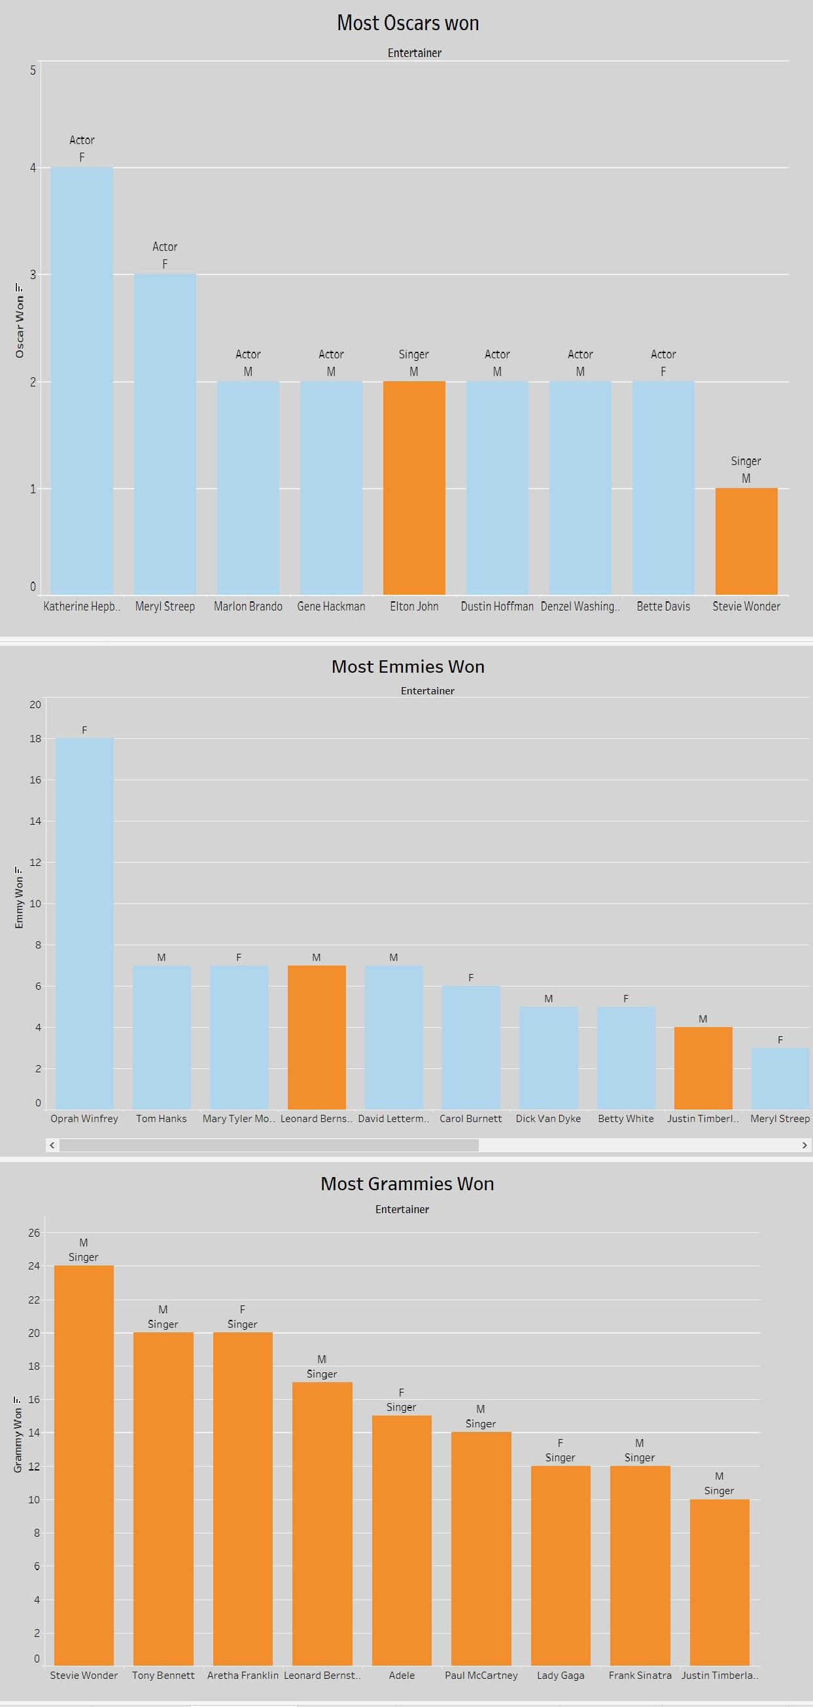
➤Most Oscars Won
➤Most Emmies Won
➤Most Grammies Won

Slide 12
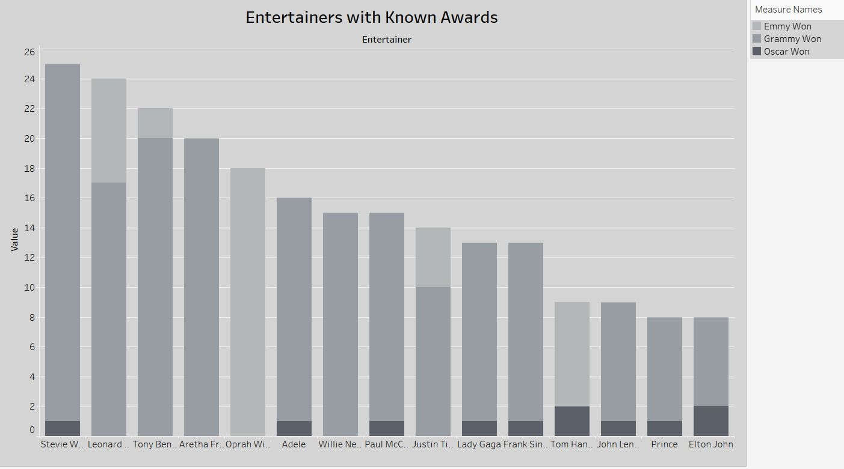
Visuals
➤Entertainers who won the mega awards
➤Dark Grey shows the Oscars won count, Grey shows the Grammy won count and light Grey shows the Emmy won count

Slide 13
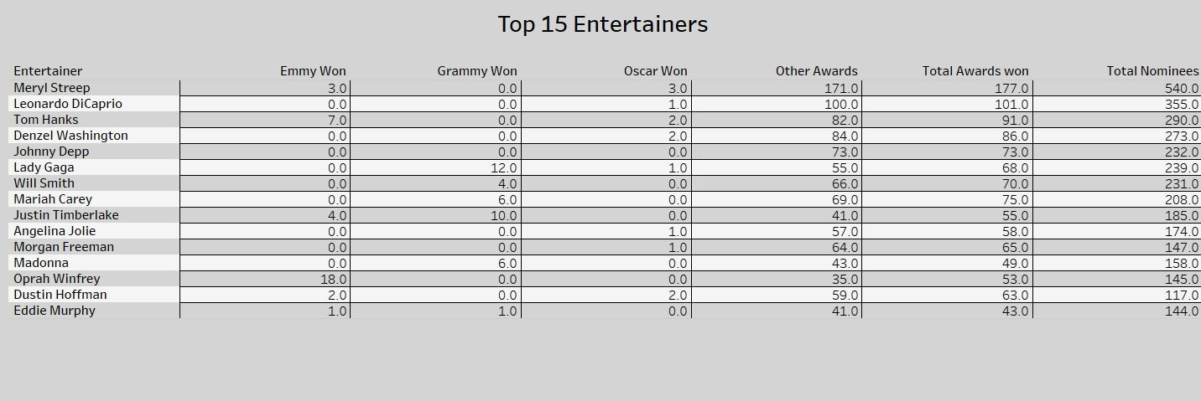
Visuals
➤Top 15 Entertainers

Slide 14
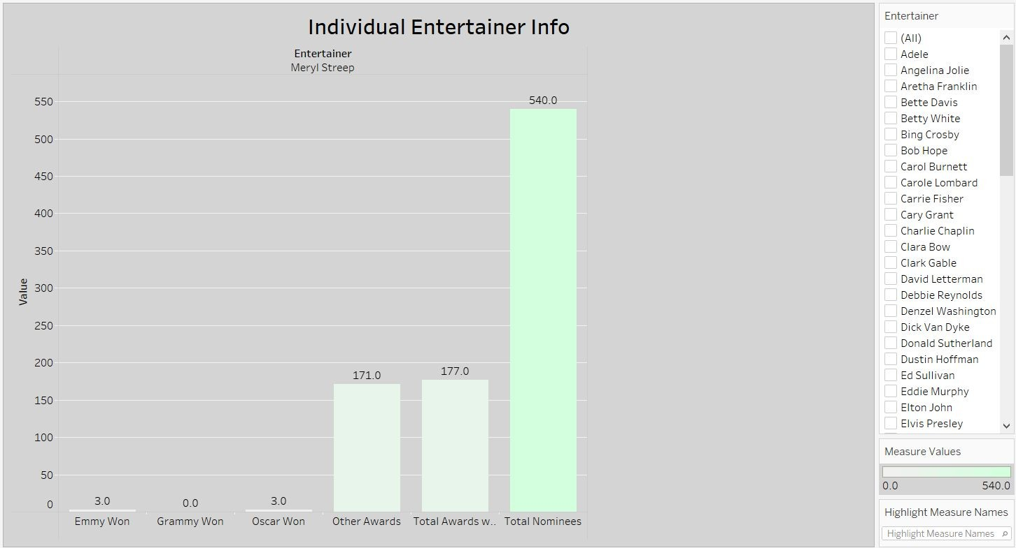
Visuals
➤This Graph shows the data according to the filters provided and changes according to the each entertainer.It is the Individual data analysis.

Slide 15
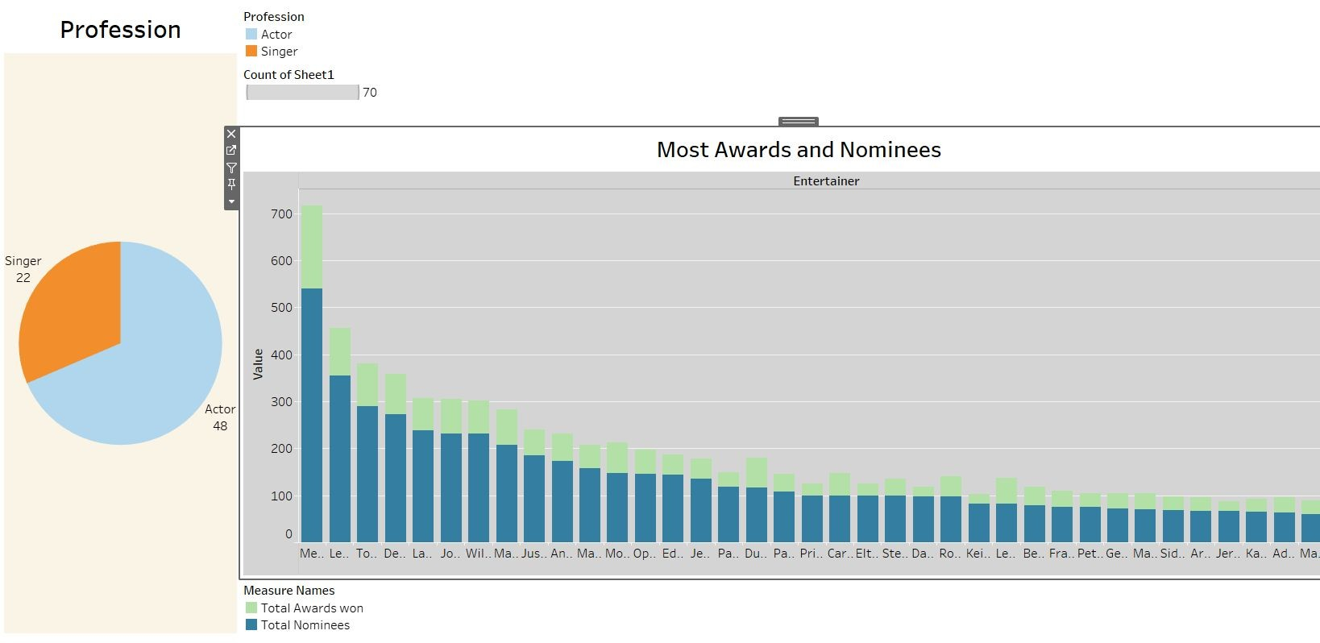
Dashboard 1

Slide 16
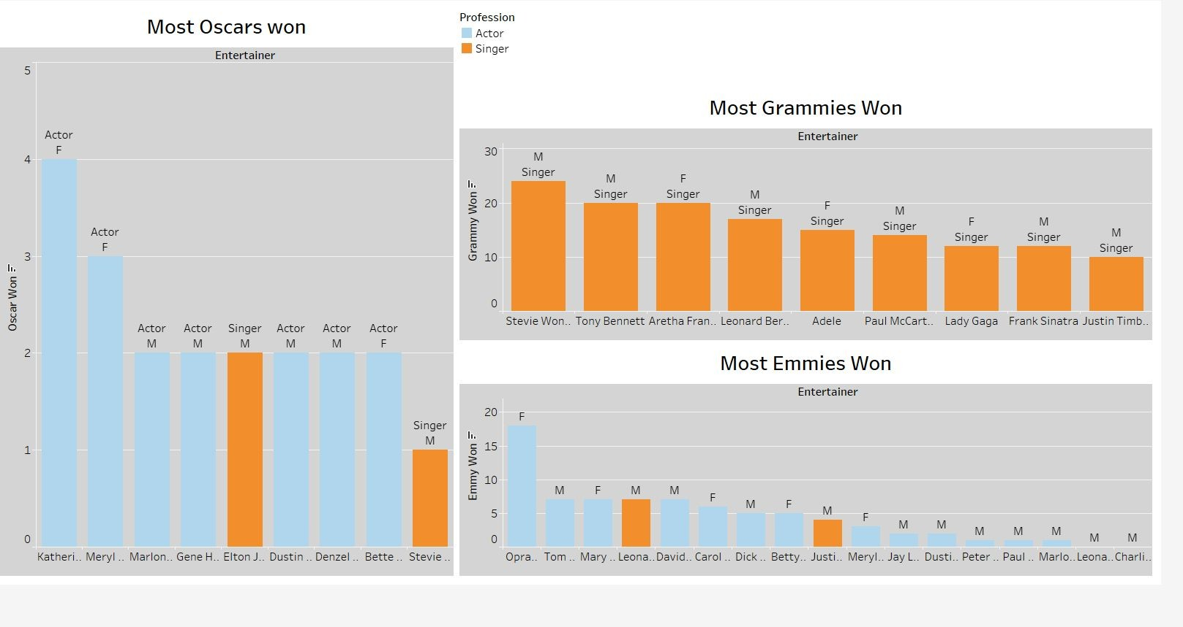
Dashboard 2

Slide 17
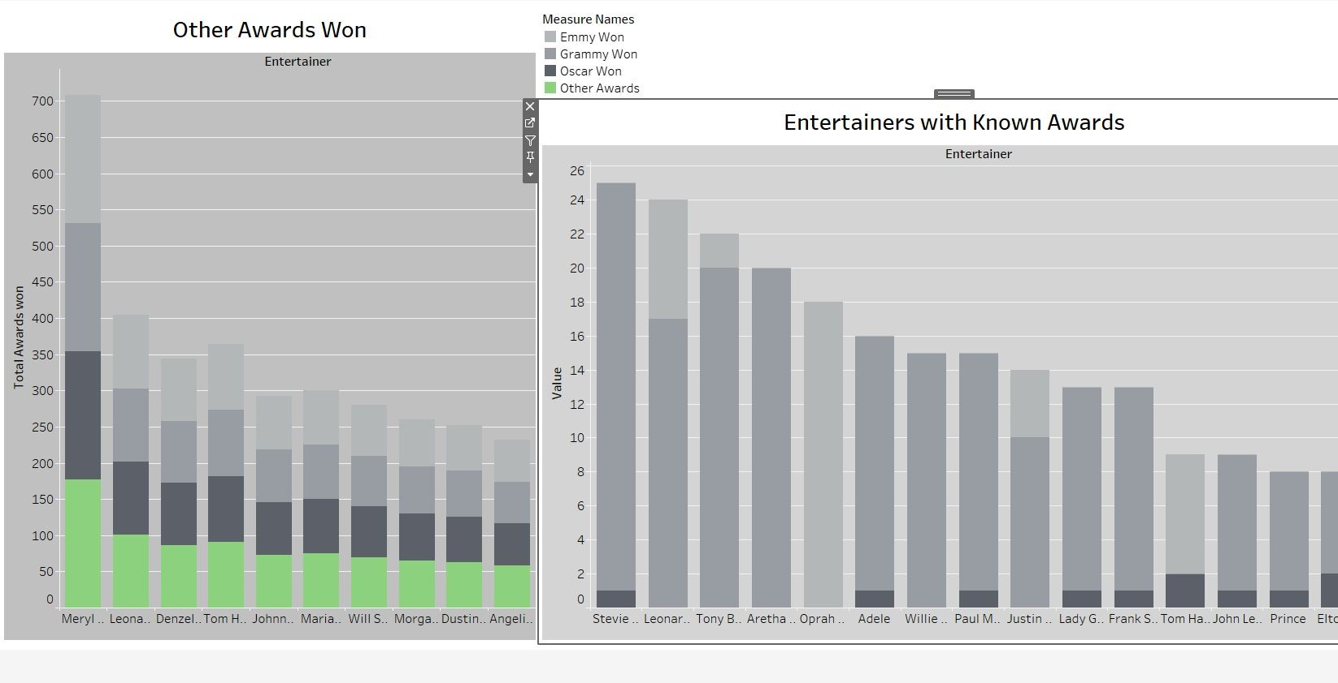
Dashboard 3

Slide 18
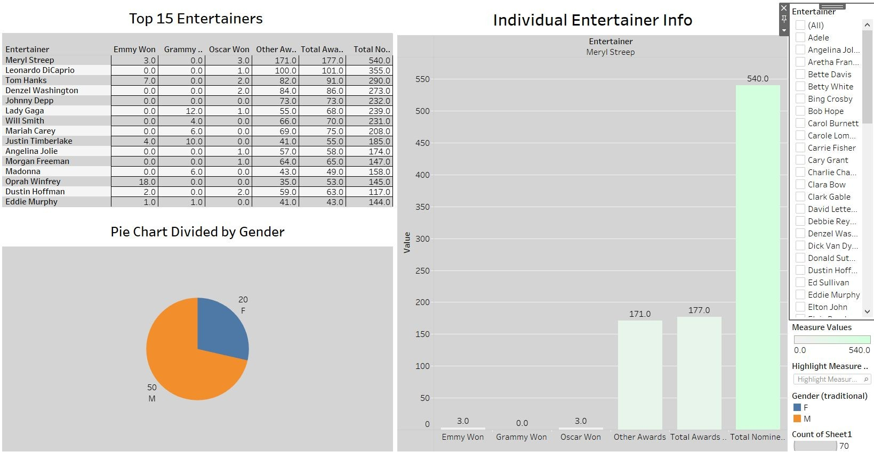
Dashboard 4

Slide 19
Analysis
□➤ Meryl streep is the best entertainer with 177 total wins including 3 Oscars and 3 Emmys also she has 540 nominees
□
➤ Most of the Entertainers are From Actors category.
□
➤ Katherine Hepburn has the Highest Oscars (4).
□
➤ Oprah Winfrey has the Highest Emmies (18).
□
➤ Stevie Wonder has the Highest Grammies (24).
□
➤ Stevie Wonder has the Highest Known awards (24 Grammies + 1 Oscar)
□
➤There are very less entertainers who won awards from their breakthrough
□

Slide 20

Thank you!
To those who Saw this and Contributed their Interest.

